Slide 1

KDD Cup 2017 期末報告 2017/06/08
課程名稱：類神經網路
指導老師：李漢銘 教授
學生：呂天桂D04921008
林柏年R05921022
楊智翔R05921027

Slide 2


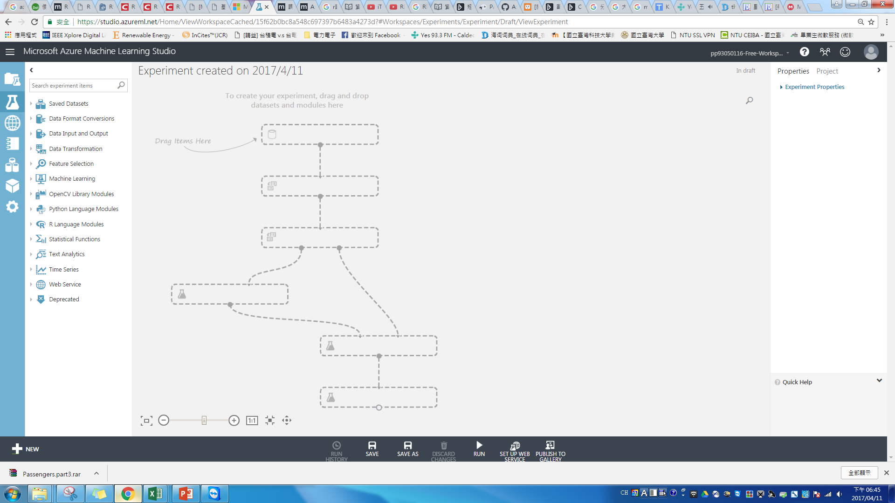
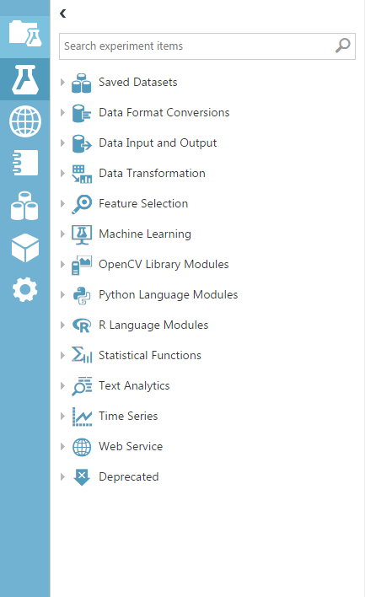
使用工具及平台
Microsoft Azure雲端中之 Machine Learning

Slide 3
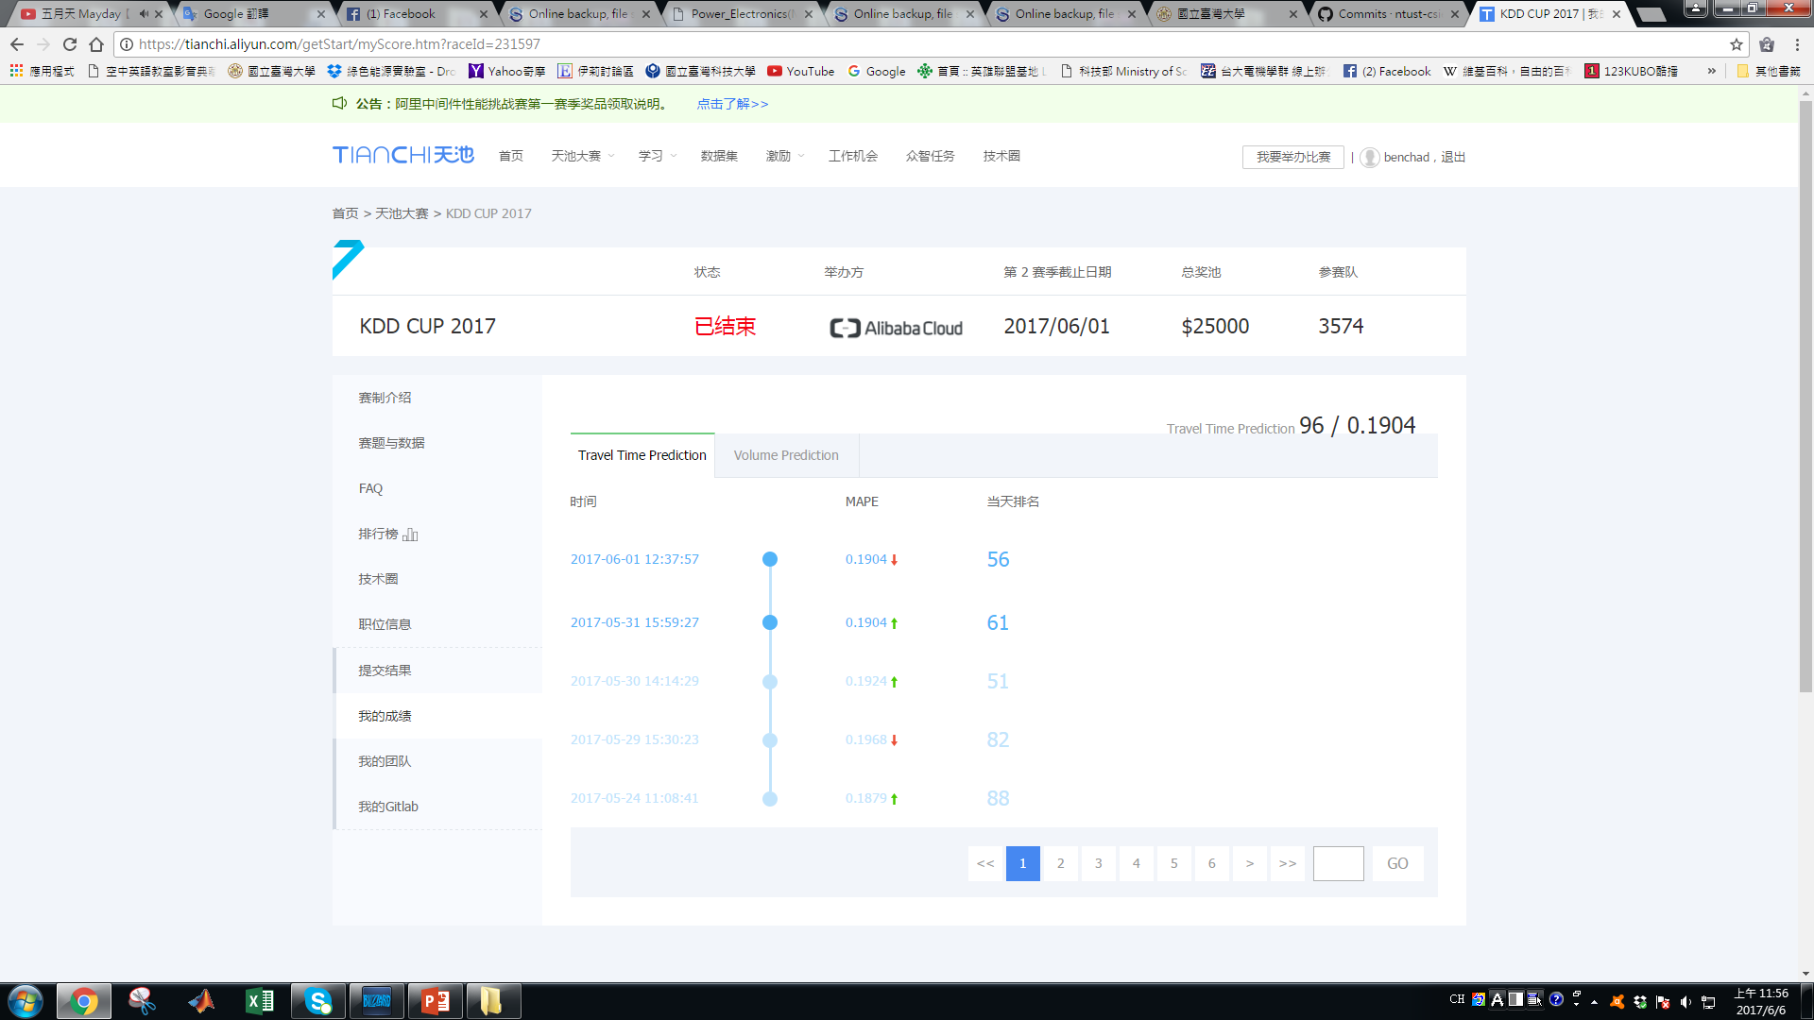
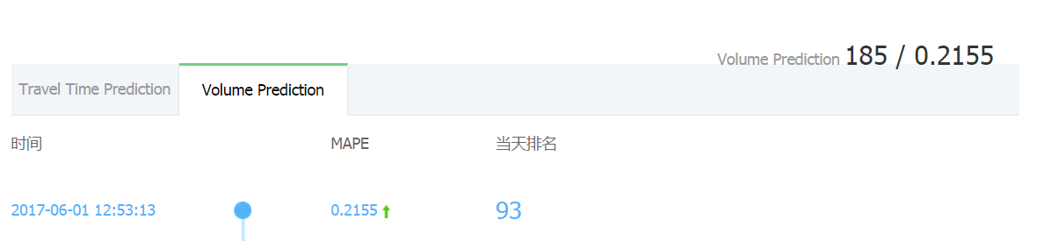
Tasks
Task 1: To estimate the average travel time from designated intersections to tollgates
MAPE：0.1904
最後排名：96
Task 2: To predict average tollgate traffic volume
MAPE：0.2155
最後排名：185

Slide 4
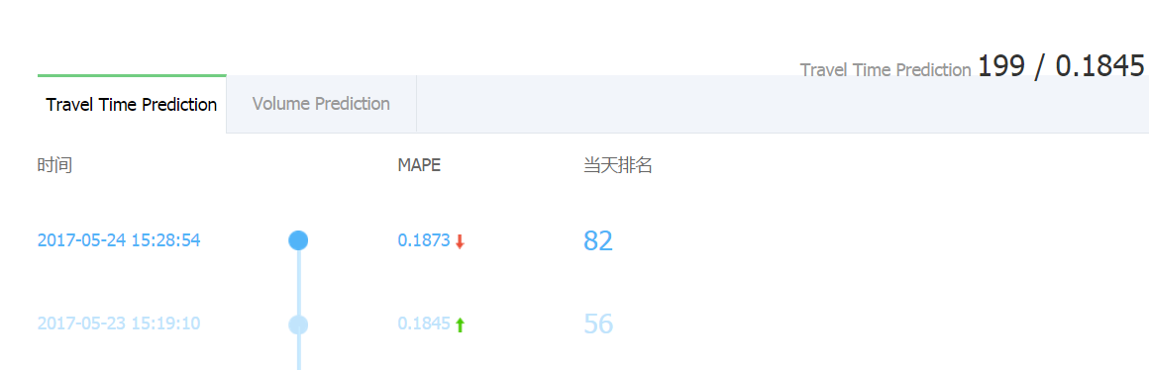
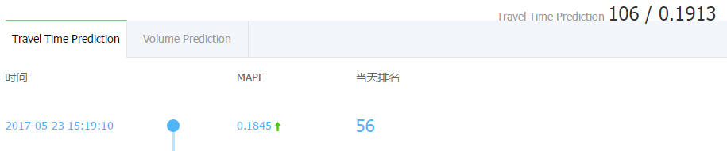
Task 1 任務
To estimate the average travel time from designated intersections to tollgates
第一階段:預測10/18-10/24日期的早上8、9點和下午5、6點
第一階段
MAPE：0.1845
排名：199
第二階段:預測10/25-10/31日期的早上8、9點和下午5、6點
第二階段
MAPE：0.1904
排名：96

Slide 5
第一階段
Step1：決定特徵
特徵 : 路口、收費站、星期、小時、分鐘以20完一單位、旅行時間
天氣 : 下雨機率
 | A | B | C | D | E | F
1 | intersection_id | tollgate_id | starting_time_week | starting_timeH | starting_timeSEC | travel_time
2 | A | 2 | 2 | 6 | 0 | 27.54
3 | C | 3 | 2 | 6 | 0 | 139.53
+
date | hour | pressure | sea_pressure | wind_direction | wind_speed | temperature | rel_humidity | precipitation
2016/10/18 | 0 | 1015.2 | 1020.3 | 62 | 2.1 | 20.5 | 87 | 0
2016/10/18 | 3 | 1014.5 | 1019.5 | 37 | 2.5 | 23.3 | 73 | 0
2016/10/18 | 6 | 1012.5 | 1017.5 | 128 | 1.6 | 23.4 | 73 | 0
2016/10/18 | 9 | 1013 | 1018 | 205 | 0.6 | 20.9 | 94 | 1.8
2016/10/18 | 12 | 1013.8 | 1018.8 | 106 | 1.5 | 20.5 | 94 | 0.5
2016/10/18 | 15 | 1013.7 | 1018.7 | 90 | 1.9 | 20.1 | 95 | 0.1

Slide 6
第一階段
資料整理 : 刪除極大極小值，讓圖形更接近平穩
節慶 : 將節慶日期改為禮拜日，工作日改為星期一
演算法:使用Boosted Decision Tree Regression
使用此模塊來創建一個使用boosting的回歸樹組合 ，這種回歸方法是一種監督學習方法，將特徵值皆當成分類，所已決定採用此演算法。

Slide 7
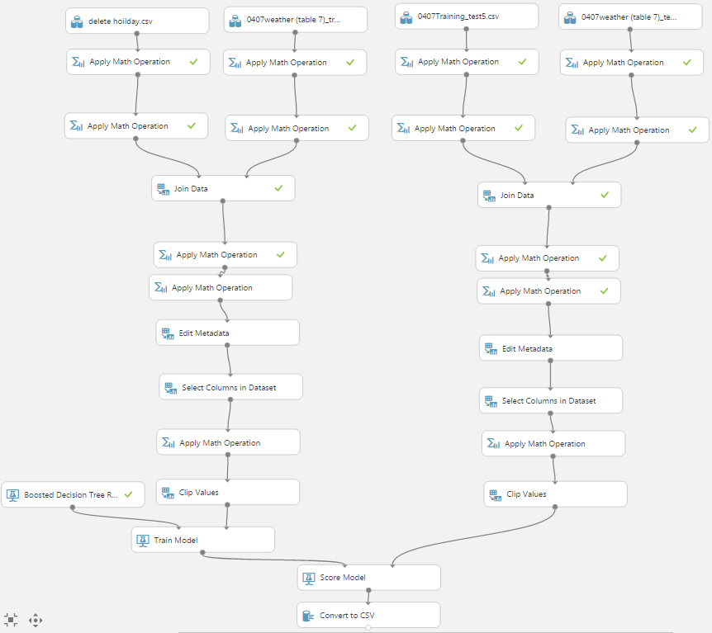
第一階段
Training
Test
Step2：訓練
將資料全部放一起訓練
路線A-2
A-3
B-1
B-3
C-1
C-2

Slide 8
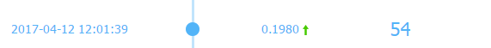
第一階段
Step2：訓練
成績: 0.1980

Slide 9
第一階段
Step2：訓練
將資料分成路線A-2、A-3、B-1、B-3、C-1、C-3
intersection_id | tollgate_id
B | 3
B | 3
B | 1
A | 2
B | 1
C | 3
B | 1
A | 2
A | 3
C | 1
A | 2
intersection_id | tollgate_id
A | 2
intersection_id | tollgate_id
A | 3
intersection_id | tollgate_id
B | 1
intersection_id | tollgate_id
B | 3
intersection_id | tollgate_id
C | 1
intersection_id | tollgate_id
C | 3

Slide 10
第一階段
Step2：訓練
成績: 0.1877

Slide 11
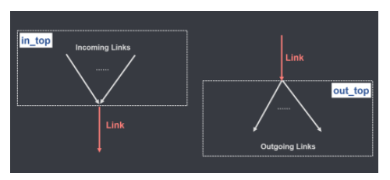
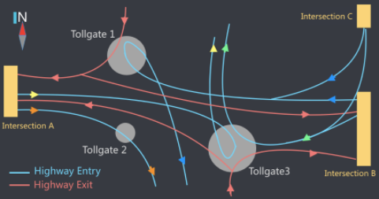
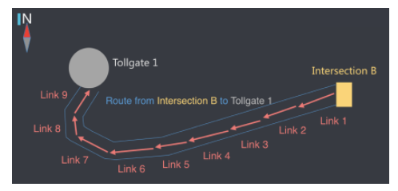
第一階段
Step2：訓練
將所有路線組合成一個大系統
link_id | length | in_top | out_top | lane_width
100 | 58 | 105 | 111 | 3
101 | 84 | 116 | 121 | 3
intersection_id | tollgate_id | link_seq
B | 1 | 105,100,111,103,116,000,000,000,000
B | 3 | 105,100,111,103,122

Slide 12
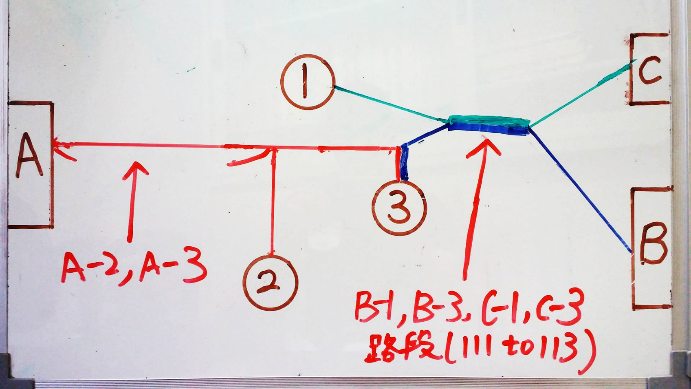
第一階段
Step2：訓練
將所有路線組合成一個大系統

Slide 13
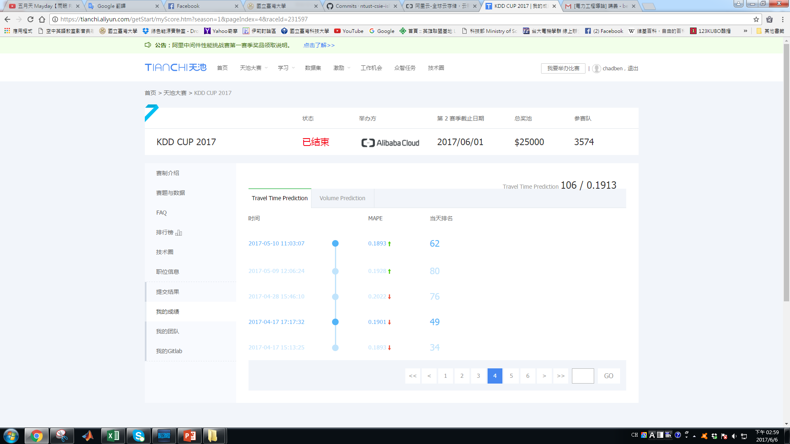
第一階段
Step2：訓練
成績: 0.1901

Slide 14
第一階段
Step2：訓練
問題所在
intersection_id | tollgate_id | traveltime_111to103 | average
B | 1 |  | 24
+
intersection_id | tollgate_id | traveltime_111to103 | average
C | 1 |  | 20
intersection_id | tollgate_id | traveltime_111to103 | average
B | 3 |  | 47
+
intersection_id | tollgate_id | traveltime_111to103 | average
C | 3 |  | 45

Slide 15
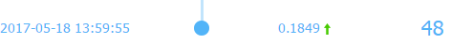
第一階段
Step2：訓練
成績: 0.1849

Slide 16
第一階段
Step2：訓練
將預測結果放進Training Data，在預測一次
Training Data
第一次預測結果
第二次預測結果

Slide 17

第一階段
Step2：訓練
成績: 0.1845

Slide 18
第二階段
Step1：決定特徵
特徵 : 路口、收費站、星期、小時、分鐘以20完一單位、旅行時間
天氣 : 下雨機率
資料整理 : 刪除極大極小值，讓圖形更接近平穩
刪除節慶
演算法:使用Boosted Decision Tree Regression

Slide 19
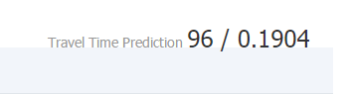
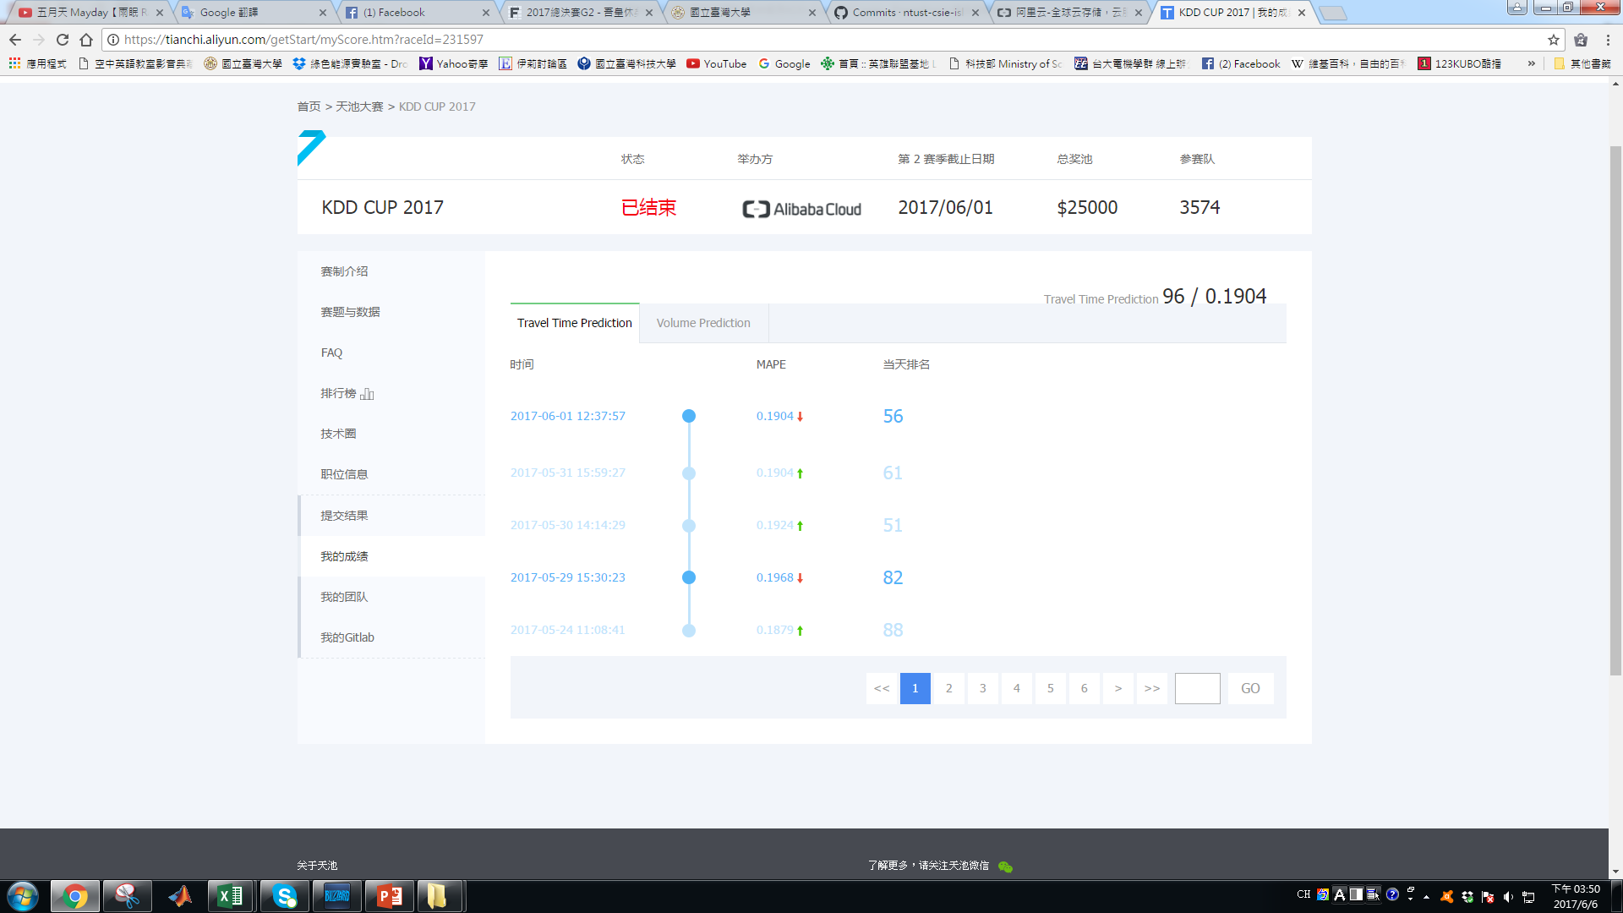


第二階段
Step2：訓練
刪除極大極小值1%
1%
2%
3%

Slide 20
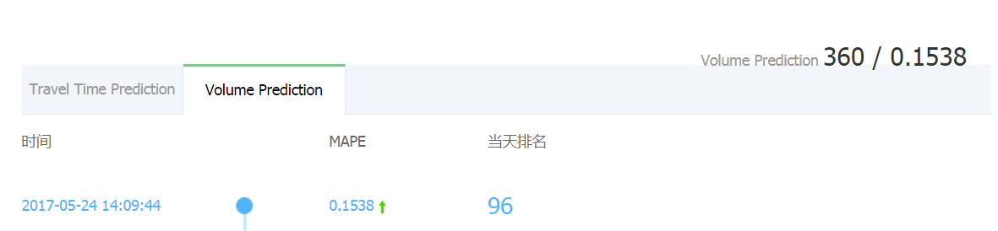
Task 2 任務
To predict average tollgate traffic volume
第一階段:預測10/18-10/24日期的早上8、9點和下午5、6點
第一階段
MAPE：0.1538
排名：360
第二階段:預測10/25-10/31日期的早上8、9點和下午5、6點
第二階段
MAPE：0.2155
排名：185

Slide 21
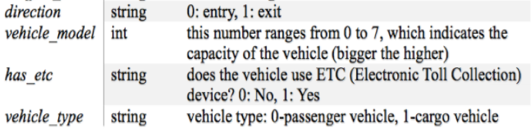
第一階段
Step1：Data processing
原始data(包括：time, tollgate_id, direction, vehicle_model, has_etc, vehicle_type)
 | A | B | C | D | E | F
1 | time | tollgate_id | direction | vehicle_model | has_etc | vehicle_type
2 | 2016/9/19 23:09 | 2 | 0 | 1 | 0
3 | 2016/9/19 23:11 | 2 | 0 | 1 | 0
4 | 2016/9/19 23:13 | 2 | 0 | 1 | 0
5 | 2016/9/19 23:17 | 1 | 0 | 1 | 1
6 | 2016/9/19 23:16 | 2 | 0 | 1 | 0
7 | 2016/9/19 23:18 | 3 | 0 | 2 | 0
8 | 2016/9/19 23:18 | 3 | 0 | 1 | 0
9 | 2016/9/19 23:19 | 2 | 0 | 1 | 0
10 | 2016/9/19 23:19 | 2 | 0 | 2 | 0
11 | 2016/9/19 23:20 | 3 | 0 | 1 | 0
12 | 2016/9/19 23:22 | 3 | 0 | 1 | 0
13 | 2016/9/19 23:23 | 1 | 0 | 2 | 0
14 | 2016/9/19 23:23 | 2 | 0 | 2 | 0
15 | 2016/9/19 23:27 | 2 | 0 | 4 | 1

Slide 22
第一階段
整理成time_data +tollgate_id, direction=>(1,0) (1,1) (2,0) (3,0) (3,1)
 | A | B | C | D | E | F | G | H | I | J | K | L | M | N | O | P | Q | R | S | T | U
 | time_data | week | timeH | timeHH | timeSECC | tollgate_id | direction | vehicle_model_0 | vehicle_model_1 | vehicle_model_2 | vehicle_model_3 | vehicle_model_4 | vehicle_model_5 | vehicle_model_6 | vehicle_model_7 | has_etc_0 | has_etc_1 | vehicle_type | vehicle_type0 | vehicle_type1 | TOTAL
1 | 2016/9/19 | 1 | 0 | 0 | 0 | 1 | 0 | 0 | 10 | 1 | 0 | 0 | 2 | 0 | 0 | 9 | 4 | 13 | 0 | 0 | 13
2 | 2016/9/19 | 1 | 0 | 0 | 1 | 1 | 0 | 0 | 6 | 0 | 0 | 0 | 0 | 0 | 0 | 5 | 1 | 6 | 0 | 0 | 6
3 | 2016/9/19 | 1 | 0 | 0 | 2 | 1 | 0 | 0 | 6 | 1 | 0 | 1 | 1 | 0 | 0 | 8 | 1 | 9 | 0 | 0 | 9
4 | 2016/9/19 | 1 | 1 | 1 | 0 | 1 | 0 | 0 | 7 | 0 | 0 | 0 | 3 | 0 | 0 | 9 | 1 | 10 | 0 | 0 | 10
5 | 2016/9/19 | 1 | 1 | 1 | 1 | 1 | 0 | 1 | 10 | 1 | 1 | 0 | 1 | 0 | 0 | 11 | 3 | 14 | 0 | 0 | 14
6 | 2016/9/19 | 1 | 1 | 1 | 2 | 1 | 0 | 0 | 9 | 0 | 0 | 0 | 1 | 0 | 0 | 10 | 0 | 10 | 0 | 0 | 10
7 | 2016/9/19 | 1 | 2 | 2 | 0 | 1 | 0 | 0 | 3 | 1 | 0 | 1 | 2 | 0 | 0 | 6 | 1 | 7 | 0 | 0 | 7
8 | 2016/9/19 | 1 | 2 | 2 | 1 | 1 | 0 | 0 | 3 | 5 | 0 | 0 | 2 | 0 | 0 | 9 | 1 | 10 | 0 | 0 | 10
9 | 2016/9/19 | 1 | 2 | 2 | 2 | 1 | 0 | 0 | 0 | 1 | 3 | 1 | 1 | 0 | 0 | 6 | 0 | 6 | 0 | 0 | 6
10 | 2016/9/19 | 1 | 3 | 3 | 0 | 1 | 0 | 0 | 5 | 2 | 0 | 0 | 2 | 0 | 0 | 9 | 0 | 9 | 0 | 0 | 9
11 | 2016/9/19 | 1 | 3 | 3 | 1 | 1 | 0 | 0 | 3 | 0 | 1 | 0 | 0 | 0 | 0 | 3 | 1 | 4 | 0 | 0 | 4
12 | 2016/9/19 | 1 | 3 | 3 | 2 | 1 | 0 | 0 | 5 | 1 | 2 | 0 | 1 | 0 | 0 | 7 | 2 | 9 | 0 | 0 | 9
13 | 2016/9/19 | 1 | 4 | 4 | 0 | 1 | 0 | 0 | 6 | 2 | 1 | 0 | 1 | 0 | 0 | 10 | 0 | 10 | 0 | 0 | 10
14 | 2016/9/19 | 1 | 4 | 4 | 1 | 1 | 0 | 0 | 9 | 2 | 1 | 0 | 1 | 0 | 0 | 13 | 0 | 13 | 0 | 0 | 13
15 | 2016/9/19 | 1 | 4 | 4 | 2 | 1 | 0 | 0 | 8 | 2 | 1 | 0 | 1 | 0 | 0 | 12 | 0 | 12 | 0 | 0 | 12
16 | 2016/9/19 | 1 | 5 | 5 | 0 | 1 | 0 | 0 | 0 | 2 | 0 | 0 | 0 | 0 | 0 | 2 | 0 | 2 | 0 | 0 | 2
17 | 2016/9/19 | 1 | 5 | 5 | 1 | 1 | 0 | 0 | 6 | 2 | 0 | 0 | 0 | 0 | 0 | 6 | 2 | 8 | 0 | 0 | 8
18 | 2016/9/19 | 1 | 5 | 5 | 2 | 1 | 0 | 0 | 12 | 1 | 0 | 0 | 0 | 0 | 0 | 11 | 2 | 13 | 0 | 0 | 13
19 | 2016/9/19 | 1 | 6 | 6 | 0 | 1 | 0 | 0 | 7 | 0 | 1 | 0 | 0 | 0 | 0 | 6 | 2 | 8 | 0 | 0 | 8
20 | 2016/9/19 | 1 | 6 | 6 | 1 | 1 | 0 | 0 | 12 | 1 | 0 | 0 | 0 | 0 | 0 | 8 | 5 | 13 | 0 | 0 | 13

Slide 23
第一階段
觀察vehicle_model_0-7，哪一個影響Total的值較明顯=>vehicle_model_1
 | A | B | C | D | E | F | G | H | I | J | K | L | M | N | O | P | Q | R | S | T | U
1 | time_data | week | timeH | timeHH | timeSECC | tollgate_id | direction | vehicle_model_0 | vehicle_model_1 | vehicle_model_2 | vehicle_model_3 | vehicle_model_4 | vehicle_model_5 | vehicle_model_6 | vehicle_model_7 | has_etc_0 | has_etc_1 | vehicle_type | vehicle_type0 | vehicle_type1 | TOTAL
2 | 2016/10/18 | 2 | 6 | 6 | 0 | 1 | 0 | 0 | 13 | 0 | 0 | 0 | 0 | 0 | 0 | 11 | 2 | 13 | 0 | 0 | 13
3 | 2016/10/18 | 2 | 6 | 6 | 1 | 1 | 0 | 0 | 13 | 4 | 0 | 0 | 0 | 0 | 0 | 12 | 5 | 17 | 0 | 0 | 17
4 | 2016/10/18 | 2 | 6 | 6 | 2 | 1 | 0 | 0 | 16 | 3 | 2 | 0 | 0 | 0 | 0 | 12 | 9 | 21 | 0 | 0 | 21
5 | 2016/10/18 | 2 | 7 | 7 | 0 | 1 | 0 | 0 | 22 | 7 | 0 | 2 | 0 | 0 | 0 | 18 | 13 | 31 | 0 | 0 | 31
6 | 2016/10/18 | 2 | 7 | 7 | 1 | 1 | 0 | 0 | 25 | 3 | 0 | 0 | 0 | 0 | 0 | 23 | 5 | 28 | 0 | 0 | 28
7 | 2016/10/18 | 2 | 7 | 7 | 2 | 1 | 0 | 0 | 41 | 5 | 1 | 0 | 0 | 0 | 0 | 37 | 10 | 47 | 0 | 0 | 47
8 | 2016/10/18 | 2 | 15 | 15 | 0 | 1 | 0 | 0 | 48 | 4 | 0 | 0 | 0 | 0 | 0 | 39 | 13 | 52 | 0 | 0 | 52
9 | 2016/10/18 | 2 | 15 | 15 | 1 | 1 | 0 | 0 | 36 | 2 | 0 | 0 | 0 | 0 | 0 | 31 | 7 | 38 | 0 | 0 | 38
10 | 2016/10/18 | 2 | 15 | 15 | 2 | 1 | 0 | 0 | 35 | 0 | 0 | 0 | 0 | 0 | 0 | 24 | 11 | 35 | 0 | 0 | 35
11 | 2016/10/18 | 2 | 16 | 16 | 0 | 1 | 0 | 0 | 55 | 2 | 0 | 0 | 0 | 0 | 0 | 45 | 12 | 57 | 0 | 0 | 57
12 | 2016/10/18 | 2 | 16 | 16 | 1 | 1 | 0 | 0 | 42 | 2 | 0 | 1 | 0 | 0 | 0 | 30 | 15 | 45 | 0 | 0 | 45
13 | 2016/10/18 | 2 | 16 | 16 | 2 | 1 | 0 | 0 | 46 | 7 | 0 | 0 | 0 | 0 | 0 | 37 | 16 | 53 | 0 | 0 | 53
14 | 2016/10/19 | 3 | 6 | 6 | 0 | 1 | 0 | 0 | 10 | 2 | 0 | 0 | 0 | 0 | 0 | 11 | 1 | 12 | 0 | 0 | 12
15 | 2016/10/19 | 3 | 6 | 6 | 1 | 1 | 0 | 0 | 13 | 3 | 0 | 0 | 0 | 0 | 0 | 12 | 4 | 16 | 0 | 0 | 16
16 | 2016/10/19 | 3 | 6 | 6 | 2 | 1 | 0 | 0 | 11 | 3 | 2 | 1 | 0 | 0 | 0 | 13 | 4 | 17 | 0 | 0 | 17
17 | 2016/10/19 | 3 | 7 | 7 | 0 | 1 | 0 | 0 | 15 | 5 | 1 | 1 | 0 | 0 | 0 | 13 | 9 | 22 | 0 | 0 | 22
18 | 2016/10/19 | 3 | 7 | 7 | 1 | 1 | 0 | 0 | 33 | 5 | 0 | 0 | 0 | 0 | 0 | 28 | 10 | 38 | 0 | 0 | 38
19 | 2016/10/19 | 3 | 7 | 7 | 2 | 1 | 0 | 0 | 38 | 3 | 0 | 0 | 0 | 0 | 0 | 26 | 15 | 41 | 0 | 0 | 41
20 | 2016/10/19 | 3 | 15 | 15 | 0 | 1 | 0 | 0 | 35 | 5 | 0 | 0 | 0 | 0 | 0 | 32 | 8 | 40 | 0 | 0 | 40
21 | 2016/10/19 | 3 | 15 | 15 | 1 | 1 | 0 | 0 | 31 | 3 | 0 | 0 | 0 | 0 | 0 | 25 | 9 | 34 | 0 | 0 | 34
22 | 2016/10/19 | 3 | 15 | 15 | 2 | 1 | 0 | 0 | 45 | 5 | 0 | 0 | 0 | 0 | 0 | 34 | 16 | 50 | 0 | 0 | 50
 | 2016/10/19 | 3 | 16 | 16 | 0 | 1 | 0 | 0 | 38 | 1 | 0 | 0 | 0 | 0 | 0 | 34 | 5 | 39 | 0 | 0 | 39

Slide 24
第一階段
以testing (tollgate_id 1, direction 0)為例：
※(6、7點與15、16點要分開觀察)

Slide 25
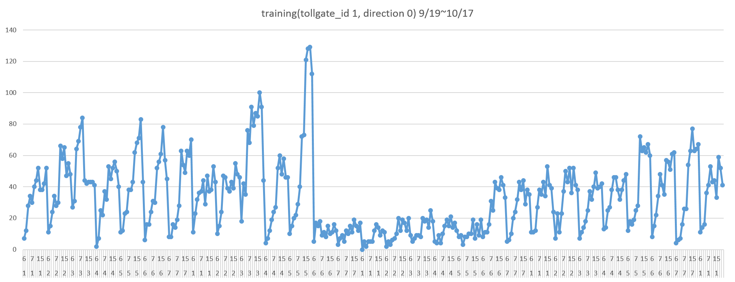
第一階段
以training (tollgate_id 1, direction 0)為例：
刪除異值!!
Chinese national holiday

Slide 26
第一階段
以training (tollgate_id 1, direction 0)為例：
刪除異值後，使training與testing趨勢較相近

Slide 27
第一階段
 | A | B | C | D | E | F | G | H | I
1 | time_data | week | timeH | timeHH | timeSECC | tollgate_id | direction | model | vehicle_model_0
2 | 2016/9/19 | 1 | 0 | 0 | 0 | 1 | 0 | 0 | 0
3 | 2016/9/19 | 1 | 0 | 0 | 1 | 1 | 0 | 0 | 0
4 | 2016/9/19 | 1 | 0 | 0 | 2 | 1 | 0 | 0 | 0
5 | 2016/9/19 | 1 | 1 | 1 | 0 | 1 | 0 | 0 | 0
6 | 2016/9/19 | 1 | 1 | 1 | 1 | 1 | 0 | 0 | 1
7 | 2016/9/19 | 1 | 1 | 1 | 2 | 1 | 0 | 0 | 0
8 | 2016/9/19 | 1 | 2 | 2 | 0 | 1 | 0 | 0 | 0
9 | 2016/9/19 | 1 | 2 | 2 | 1 | 1 | 0 | 0 | 0
10 | 2016/9/19 | 1 | 2 | 2 | 2 | 1 | 0 | 0 | 0
11 | 2016/9/19 | 1 | 3 | 3 | 0 | 1 | 0 | 0 | 0
12 | 2016/9/19 | 1 | 3 | 3 | 1 | 1 | 0 | 0 | 0
13 | 2016/9/19 | 1 | 3 | 3 | 2 | 1 | 0 | 0 | 0
14 | 2016/9/19 | 1 | 4 | 4 | 0 | 1 | 0 | 0 | 0
15 | 2016/9/19 | 1 | 4 | 4 | 1 | 1 | 0 | 0 | 0
16 | 2016/9/19 | 1 | 4 | 4 | 2 | 1 | 0 | 0 | 0
17 | 2016/9/19 | 1 | 5 | 5 | 0 | 1 | 0 | 0 | 0
18 | 2016/9/19 | 1 | 5 | 5 | 1 | 1 | 0 | 0 | 0
19 | 2016/9/19 | 1 | 5 | 5 | 2 | 1 | 0 | 0 | 0
 | A | B | C | D | E | F | G | H | I | J | K | L | M | N | O | P | Q | R | S | T | U
 | time_data | week | timeH | timeHH | timeSECC | tollgate_id | direction | vehicle_model_0 | vehicle_model_1 | vehicle_model_2 | vehicle_model_3 | vehicle_model_4 | vehicle_model_5 | vehicle_model_6 | vehicle_model_7 | has_etc_0 | has_etc_1 | vehicle_type | vehicle_type0 | vehicle_type1 | TOTAL
1 | 2016/9/19 | 1 | 0 | 0 | 0 | 1 | 0 | 0 | 10 | 1 | 0 | 0 | 2 | 0 | 0 | 9 | 4 | 13 | 0 | 0 | 13
2 | 2016/9/19 | 1 | 0 | 0 | 1 | 1 | 0 | 0 | 6 | 0 | 0 | 0 | 0 | 0 | 0 | 5 | 1 | 6 | 0 | 0 | 6
3 | 2016/9/19 | 1 | 0 | 0 | 2 | 1 | 0 | 0 | 6 | 1 | 0 | 1 | 1 | 0 | 0 | 8 | 1 | 9 | 0 | 0 | 9
4 | 2016/9/19 | 1 | 1 | 1 | 0 | 1 | 0 | 0 | 7 | 0 | 0 | 0 | 3 | 0 | 0 | 9 | 1 | 10 | 0 | 0 | 10
5 | 2016/9/19 | 1 | 1 | 1 | 1 | 1 | 0 | 1 | 10 | 1 | 1 | 0 | 1 | 0 | 0 | 11 | 3 | 14 | 0 | 0 | 14
6 | 2016/9/19 | 1 | 1 | 1 | 2 | 1 | 0 | 0 | 9 | 0 | 0 | 0 | 1 | 0 | 0 | 10 | 0 | 10 | 0 | 0 | 10
7 | 2016/9/19 | 1 | 2 | 2 | 0 | 1 | 0 | 0 | 3 | 1 | 0 | 1 | 2 | 0 | 0 | 6 | 1 | 7 | 0 | 0 | 7
8 | 2016/9/19 | 1 | 2 | 2 | 1 | 1 | 0 | 0 | 3 | 5 | 0 | 0 | 2 | 0 | 0 | 9 | 1 | 10 | 0 | 0 | 10
9 | 2016/9/19 | 1 | 2 | 2 | 2 | 1 | 0 | 0 | 0 | 1 | 3 | 1 | 1 | 0 | 0 | 6 | 0 | 6 | 0 | 0 | 6
10 | 2016/9/19 | 1 | 3 | 3 | 0 | 1 | 0 | 0 | 5 | 2 | 0 | 0 | 2 | 0 | 0 | 9 | 0 | 9 | 0 | 0 | 9
11 | 2016/9/19 | 1 | 3 | 3 | 1 | 1 | 0 | 0 | 3 | 0 | 1 | 0 | 0 | 0 | 0 | 3 | 1 | 4 | 0 | 0 | 4
12 | 2016/9/19 | 1 | 3 | 3 | 2 | 1 | 0 | 0 | 5 | 1 | 2 | 0 | 1 | 0 | 0 | 7 | 2 | 9 | 0 | 0 | 9
13 | 2016/9/19 | 1 | 4 | 4 | 0 | 1 | 0 | 0 | 6 | 2 | 1 | 0 | 1 | 0 | 0 | 10 | 0 | 10 | 0 | 0 | 10
14 | 2016/9/19 | 1 | 4 | 4 | 1 | 1 | 0 | 0 | 9 | 2 | 1 | 0 | 1 | 0 | 0 | 13 | 0 | 13 | 0 | 0 | 13
15 | 2016/9/19 | 1 | 4 | 4 | 2 | 1 | 0 | 0 | 8 | 2 | 1 | 0 | 1 | 0 | 0 | 12 | 0 | 12 | 0 | 0 | 12
16 | 2016/9/19 | 1 | 5 | 5 | 0 | 1 | 0 | 0 | 0 | 2 | 0 | 0 | 0 | 0 | 0 | 2 | 0 | 2 | 0 | 0 | 2
17 | 2016/9/19 | 1 | 5 | 5 | 1 | 1 | 0 | 0 | 6 | 2 | 0 | 0 | 0 | 0 | 0 | 6 | 2 | 8 | 0 | 0 | 8
18 | 2016/9/19 | 1 | 5 | 5 | 2 | 1 | 0 | 0 | 12 | 1 | 0 | 0 | 0 | 0 | 0 | 11 | 2 | 13 | 0 | 0 | 13
19 | 2016/9/19 | 1 | 6 | 6 | 0 | 1 | 0 | 0 | 7 | 0 | 1 | 0 | 0 | 0 | 0 | 6 | 2 | 8 | 0 | 0 | 8
20 | 2016/9/19 | 1 | 6 | 6 | 1 | 1 | 0 | 0 | 12 | 1 | 0 | 0 | 0 | 0 | 0 | 8 | 5 | 13 | 0 | 0 | 13

Slide 28
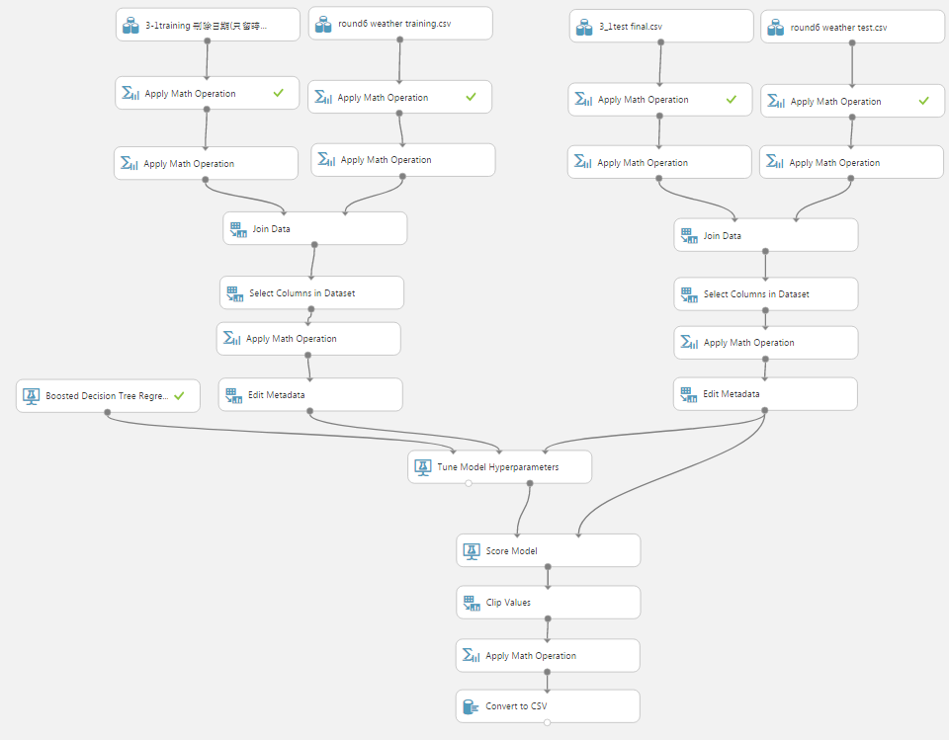
第一階段
Training
Test
Step2：訓練
將資料全部放一起訓練
tollgate_id, direction=>
(1,0)
(1,1)
(2,0)
(3,0)
(3,1)

Slide 29

第一階段
Step2：訓練
成績: 0.2007
成績相較下，MAPE偏高，可能原因
training dataSets Feature Selection太多
weather dataSets Feature Selection太少(只選擇precipitation)

Slide 30
第一階段
Step2：訓練
 | A | B | C | D | E | F | G | H | I | J | K | L | M | N | O | P | Q | R | S | T | U
 | time_data | week | timeH | timeHH | timeSECC | tollgate_id | direction | vehicle_model_0 | vehicle_model_1 | vehicle_model_2 | vehicle_model_3 | vehicle_model_4 | vehicle_model_5 | vehicle_model_6 | vehicle_model_7 | has_etc_0 | has_etc_1 | vehicle_type | vehicle_type0 | vehicle_type1 | TOTAL
1 | 2016/9/19 | 1 | 0 | 0 | 0 | 1 | 0 | 0 | 10 | 1 | 0 | 0 | 2 | 0 | 0 | 9 | 4 | 13 | 0 | 0 | 13
2 | 2016/9/19 | 1 | 0 | 0 | 1 | 1 | 0 | 0 | 6 | 0 | 0 | 0 | 0 | 0 | 0 | 5 | 1 | 6 | 0 | 0 | 6
3 | 2016/9/19 | 1 | 0 | 0 | 2 | 1 | 0 | 0 | 6 | 1 | 0 | 1 | 1 | 0 | 0 | 8 | 1 | 9 | 0 | 0 | 9
4 | 2016/9/19 | 1 | 1 | 1 | 0 | 1 | 0 | 0 | 7 | 0 | 0 | 0 | 3 | 0 | 0 | 9 | 1 | 10 | 0 | 0 | 10
5 | 2016/9/19 | 1 | 1 | 1 | 1 | 1 | 0 | 1 | 10 | 1 | 1 | 0 | 1 | 0 | 0 | 11 | 3 | 14 | 0 | 0 | 14
6 | 2016/9/19 | 1 | 1 | 1 | 2 | 1 | 0 | 0 | 9 | 0 | 0 | 0 | 1 | 0 | 0 | 10 | 0 | 10 | 0 | 0 | 10
7 | 2016/9/19 | 1 | 2 | 2 | 0 | 1 | 0 | 0 | 3 | 1 | 0 | 1 | 2 | 0 | 0 | 6 | 1 | 7 | 0 | 0 | 7
8 | 2016/9/19 | 1 | 2 | 2 | 1 | 1 | 0 | 0 | 3 | 5 | 0 | 0 | 2 | 0 | 0 | 9 | 1 | 10 | 0 | 0 | 10
9 | 2016/9/19 | 1 | 2 | 2 | 2 | 1 | 0 | 0 | 0 | 1 | 3 | 1 | 1 | 0 | 0 | 6 | 0 | 6 | 0 | 0 | 6
10 | 2016/9/19 | 1 | 3 | 3 | 0 | 1 | 0 | 0 | 5 | 2 | 0 | 0 | 2 | 0 | 0 | 9 | 0 | 9 | 0 | 0 | 9
11 | 2016/9/19 | 1 | 3 | 3 | 1 | 1 | 0 | 0 | 3 | 0 | 1 | 0 | 0 | 0 | 0 | 3 | 1 | 4 | 0 | 0 | 4
12 | 2016/9/19 | 1 | 3 | 3 | 2 | 1 | 0 | 0 | 5 | 1 | 2 | 0 | 1 | 0 | 0 | 7 | 2 | 9 | 0 | 0 | 9
13 | 2016/9/19 | 1 | 4 | 4 | 0 | 1 | 0 | 0 | 6 | 2 | 1 | 0 | 1 | 0 | 0 | 10 | 0 | 10 | 0 | 0 | 10
14 | 2016/9/19 | 1 | 4 | 4 | 1 | 1 | 0 | 0 | 9 | 2 | 1 | 0 | 1 | 0 | 0 | 13 | 0 | 13 | 0 | 0 | 13
15 | 2016/9/19 | 1 | 4 | 4 | 2 | 1 | 0 | 0 | 8 | 2 | 1 | 0 | 1 | 0 | 0 | 12 | 0 | 12 | 0 | 0 | 12
16 | 2016/9/19 | 1 | 5 | 5 | 0 | 1 | 0 | 0 | 0 | 2 | 0 | 0 | 0 | 0 | 0 | 2 | 0 | 2 | 0 | 0 | 2
17 | 2016/9/19 | 1 | 5 | 5 | 1 | 1 | 0 | 0 | 6 | 2 | 0 | 0 | 0 | 0 | 0 | 6 | 2 | 8 | 0 | 0 | 8
18 | 2016/9/19 | 1 | 5 | 5 | 2 | 1 | 0 | 0 | 12 | 1 | 0 | 0 | 0 | 0 | 0 | 11 | 2 | 13 | 0 | 0 | 13
19 | 2016/9/19 | 1 | 6 | 6 | 0 | 1 | 0 | 0 | 7 | 0 | 1 | 0 | 0 | 0 | 0 | 6 | 2 | 8 | 0 | 0 | 8
20 | 2016/9/19 | 1 | 6 | 6 | 1 | 1 | 0 | 0 | 12 | 1 | 0 | 0 | 0 | 0 | 0 | 8 | 5 | 13 | 0 | 0 | 13

Slide 31
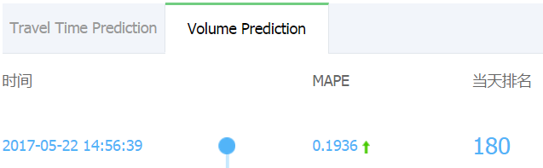
第一階段
Step2：訓練
成績: 0.1936
MAPE有降低，因為
取消model當feature，用training個別的vehicle_model，來預測testin個別的 vehicle_model，最後再將vehicle_model 0-7總和成Total，用其結果進行提交

Slide 32
第一階段
Step2：訓練

Slide 33
第一階段
再刪除更細部異值後，使training與testing趨勢更加相近

Slide 34
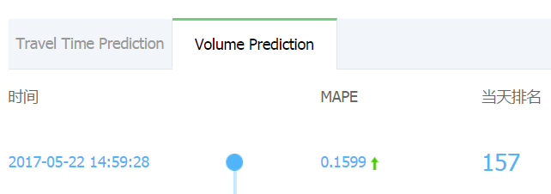
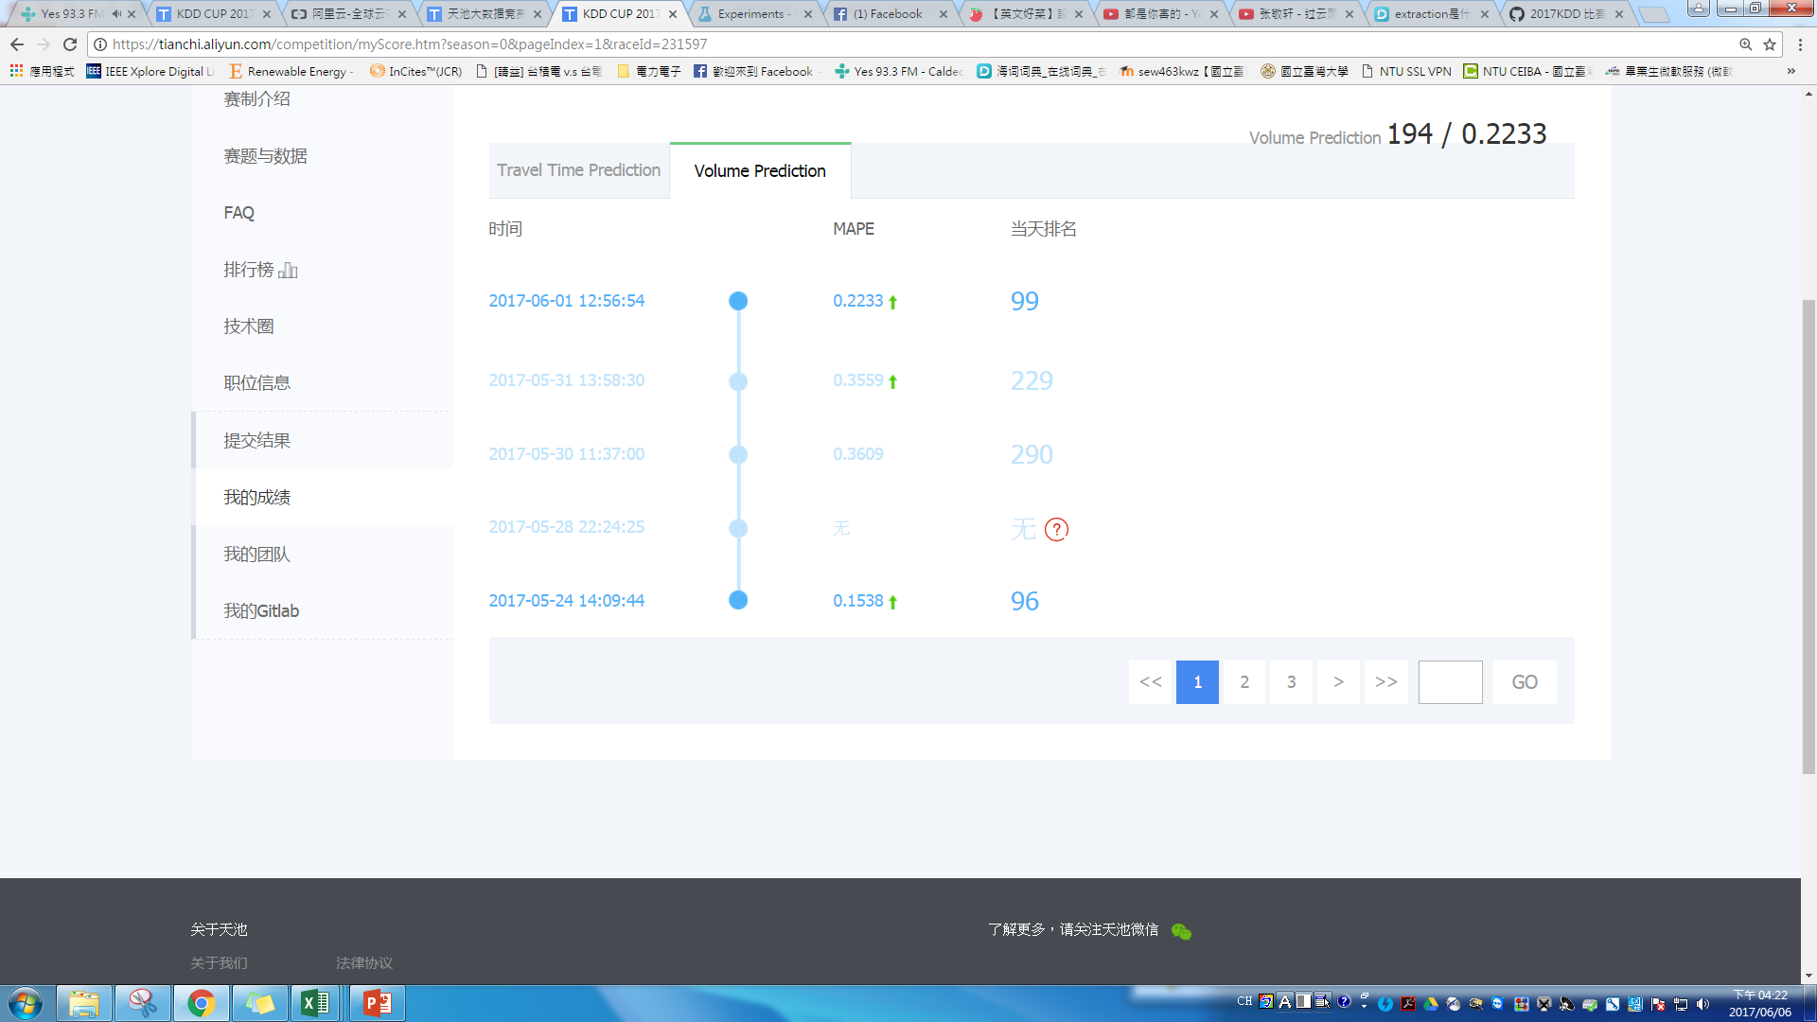
第一階段
Step2：訓練
最後成績: 0.1538

Slide 35
第二階段
Step1：Data processing
將第二階段的資料也，整理成time_data+tollgate_id, direction=>(1,0) (1,1) (2,0) (3,0) (3,1)
 | time_data | week | timeH | timeHH | timeSECC | tollgate_id | direction | vehicle_model_0 | vehicle_model_1 | vehicle_model_2 | vehicle_model_3 | vehicle_model_4 | vehicle_model_5 | vehicle_model_6 | vehicle_model_7 | has_etc_0 | has_etc_1 | vehicle_type | vehicle_type0 | vehicle_type1 | TOTAL
2086 | 2016/10/17 | 1 | 22 | 22 | 2 | 1 | 0 | 0 | 4 | 0 | 0 | 0 | 0 | 0 | 0 | 4 | 0 | 4 | 0 | 0 | 4
2087 | 2016/10/17 | 1 | 23 | 23 | 0 | 1 | 0 | 0 | 1 | 0 | 0 | 0 | 0 | 0 | 0 | 1 | 0 | 1 | 0 | 0 | 1
2088 | 2016/10/17 | 1 | 23 | 23 | 1 | 1 | 0 | 0 | 5 | 1 | 0 | 0 | 0 | 0 | 0 | 4 | 2 | 6 | 0 | 0 | 6
2089 | 2016/10/17 | 1 | 23 | 23 | 2 | 1 | 0 | 0 | 2 | 0 | 0 | 0 | 0 | 0 | 0 | 0 | 2 | 2 | 0 | 0 | 2
2090 | 2016/10/18 | 2 | 1 | 1 | 1 | 1 | 0 | 0 | 4 | 1 | 0 | 0 | 4 | 0 | 0 | 8 | 1 | 9 | 0 | 0 | 9
2091 | 2016/10/18 | 2 | 1 | 1 | 2 | 1 | 0 | 0 | 2 | 1 | 2 | 0 | 3 | 0 | 0 | 6 | 2 | 8 | 0 | 0 | 8
2092 | 2016/10/18 | 2 | 2 | 2 | 0 | 1 | 0 | 0 | 4 | 1 | 0 | 0 | 3 | 0 | 0 | 8 | 0 | 8 | 0 | 0 | 8
2093 | 2016/10/18 | 2 | 2 | 2 | 1 | 1 | 0 | 0 | 0 | 2 | 2 | 0 | 0 | 0 | 0 | 4 | 0 | 4 | 0 | 0 | 4
2094 | 2016/10/18 | 2 | 2 | 2 | 2 | 1 | 0 | 0 | 4 | 0 | 2 | 0 | 0 | 0 | 0 | 5 | 1 | 6 | 0 | 0 | 6
2095 | 2016/10/18 | 2 | 3 | 3 | 0 | 1 | 0 | 0 | 6 | 2 | 0 | 0 | 0 | 0 | 0 | 6 | 2 | 8 | 0 | 0 | 8
2096 | 2016/10/18 | 2 | 3 | 3 | 1 | 1 | 0 | 0 | 3 | 0 | 3 | 0 | 2 | 0 | 0 | 8 | 0 | 8 | 0 | 0 | 8
2097 | 2016/10/18 | 2 | 3 | 3 | 2 | 1 | 0 | 0 | 4 | 1 | 0 | 0 | 2 | 0 | 0 | 6 | 1 | 7 | 0 | 0 | 7
2098 | 2016/10/18 | 2 | 4 | 4 | 0 | 1 | 0 | 0 | 4 | 0 | 0 | 0 | 4 | 0 | 0 | 7 | 1 | 8 | 0 | 0 | 8
2099 | 2016/10/18 | 2 | 4 | 4 | 1 | 1 | 0 | 0 | 7 | 3 | 2 | 0 | 1 | 0 | 0 | 13 | 0 | 13 | 0 | 0 | 13
2100 | 2016/10/18 | 2 | 4 | 4 | 2 | 1 | 0 | 0 | 3 | 1 | 0 | 0 | 1 | 0 | 0 | 4 | 1 | 5 | 0 | 0 | 5
2101 | 2016/10/18 | 2 | 5 | 5 | 0 | 1 | 0 | 0 | 5 | 2 | 0 | 0 | 0 | 0 | 0 | 7 | 0 | 7 | 0 | 0 | 7
2102 | 2016/10/18 | 2 | 5 | 5 | 1 | 1 | 0 | 0 | 1 | 1 | 0 | 0 | 0 | 0 | 0 | 2 | 0 | 2 | 0 | 0 | 2
2103 | 2016/10/18 | 2 | 5 | 5 | 2 | 1 | 0 | 0 | 4 | 0 | 0 | 0 | 0 | 0 | 0 | 4 | 0 | 4 | 0 | 0 | 4
2104 | 2016/10/18 | 2 | 6 | 6 | 0 | 1 | 0 | 0 | 13 | 0 | 0 | 0 | 0 | 0 | 0 | 11 | 2 | 13 | 0 | 0 | 13

Slide 36
第二階段
觀察vehicle_model_0-7，哪一個影響Total的值較明顯=>vehicle_model_1
 | A | B | C | D | E | F | G | H | I | J | K | L | M | N | O | P | Q | R | S | T | U
1 | time_data | week | timeH | timeHH | timeSECC | tollgate_id | direction | vehicle_model_0 | vehicle_model_1 | vehicle_model_2 | vehicle_model_3 | vehicle_model_4 | vehicle_model_5 | vehicle_model_6 | vehicle_model_7 | has_etc_0 | has_etc_1 | vehicle_type | vehicle_type0 | vehicle_type1 | TOTAL
2 | 2016/10/25 | 2 | 6 | 6 | 0 | 1 | 0 | 0 | 4 | 6 | 0 | 0 | 0 | 0 | 0 | 10 | 0 | 10 | 0 | 0 | 10
3 | 2016/10/25 | 2 | 6 | 6 | 1 | 1 | 0 | 0 | 13 | 4 | 0 | 0 | 0 | 0 | 0 | 14 | 3 | 17 | 0 | 0 | 17
4 | 2016/10/25 | 2 | 6 | 6 | 2 | 1 | 0 | 0 | 20 | 6 | 3 | 1 | 0 | 0 | 0 | 22 | 8 | 30 | 0 | 0 | 30
5 | 2016/10/25 | 2 | 7 | 7 | 0 | 1 | 0 | 0 | 21 | 3 | 0 | 1 | 0 | 0 | 0 | 19 | 6 | 25 | 0 | 0 | 25
6 | 2016/10/25 | 2 | 7 | 7 | 1 | 1 | 0 | 0 | 34 | 4 | 0 | 0 | 0 | 0 | 0 | 24 | 14 | 38 | 0 | 0 | 38
7 | 2016/10/25 | 2 | 7 | 7 | 2 | 1 | 0 | 0 | 42 | 1 | 1 | 0 | 0 | 0 | 0 | 30 | 14 | 44 | 0 | 0 | 44
8 | 2016/10/25 | 2 | 15 | 15 | 0 | 1 | 0 | 0 | 47 | 5 | 0 | 0 | 0 | 0 | 0 | 34 | 18 | 52 | 0 | 0 | 52
9 | 2016/10/25 | 2 | 15 | 15 | 1 | 1 | 0 | 0 | 43 | 1 | 0 | 0 | 0 | 0 | 0 | 33 | 11 | 44 | 0 | 0 | 44
10 | 2016/10/25 | 2 | 15 | 15 | 2 | 1 | 0 | 0 | 38 | 8 | 0 | 0 | 0 | 0 | 0 | 33 | 13 | 46 | 0 | 0 | 46
11 | 2016/10/25 | 2 | 16 | 16 | 0 | 1 | 0 | 0 | 49 | 1 | 0 | 0 | 0 | 0 | 0 | 37 | 13 | 50 | 0 | 0 | 50
12 | 2016/10/25 | 2 | 16 | 16 | 1 | 1 | 0 | 0 | 38 | 1 | 0 | 1 | 0 | 0 | 0 | 30 | 10 | 40 | 0 | 0 | 40
13 | 2016/10/25 | 2 | 16 | 16 | 2 | 1 | 0 | 0 | 49 | 1 | 0 | 0 | 0 | 0 | 0 | 40 | 10 | 50 | 0 | 0 | 50
14 | 2016/10/26 | 3 | 6 | 6 | 0 | 1 | 0 | 0 | 8 | 4 | 0 | 0 | 0 | 0 | 0 | 9 | 3 | 12 | 0 | 0 | 12
15 | 2016/10/26 | 3 | 6 | 6 | 1 | 1 | 0 | 0 | 7 | 2 | 0 | 0 | 0 | 0 | 0 | 8 | 1 | 9 | 0 | 0 | 9
16 | 2016/10/26 | 3 | 6 | 6 | 2 | 1 | 0 | 0 | 17 | 5 | 2 | 1 | 0 | 0 | 0 | 19 | 6 | 25 | 0 | 0 | 25
17 | 2016/10/26 | 3 | 7 | 7 | 0 | 1 | 0 | 0 | 24 | 6 | 0 | 1 | 0 | 0 | 0 | 24 | 7 | 31 | 0 | 0 | 31
18 | 2016/10/26 | 3 | 7 | 7 | 1 | 1 | 0 | 0 | 27 | 5 | 0 | 0 | 0 | 0 | 0 | 22 | 10 | 32 | 0 | 0 | 32
19 | 2016/10/26 | 3 | 7 | 7 | 2 | 1 | 0 | 0 | 40 | 5 | 0 | 0 | 0 | 0 | 0 | 32 | 13 | 45 | 0 | 0 | 45
20 | 2016/10/26 | 3 | 15 | 15 | 0 | 1 | 0 | 0 | 35 | 3 | 0 | 0 | 0 | 0 | 0 | 31 | 7 | 38 | 0 | 0 | 38
21 | 2016/10/26 | 3 | 15 | 15 | 1 | 1 | 0 | 0 | 33 | 3 | 0 | 0 | 0 | 0 | 0 | 28 | 8 | 36 | 0 | 0 | 36
22 | 2016/10/26 | 3 | 15 | 15 | 2 | 1 | 0 | 0 | 42 | 2 | 0 | 0 | 0 | 0 | 0 | 30 | 14 | 44 | 0 | 0 | 44
23 | 2016/10/26 | 3 | 16 | 16 | 0 | 1 | 0 | 0 | 43 | 6 | 0 | 0 | 0 | 0 | 0 | 36 | 13 | 49 | 0 | 0 | 49
24 | 2016/10/26 | 3 | 16 | 16 | 1 | 1 | 0 | 0 | 41 | 4 | 0 | 0 | 0 | 0 | 0 | 34 | 11 | 45 | 0 | 0 | 45
25 | 2016/10/26 | 3 | 16 | 16 | 2 | 1 | 0 | 0 | 44 | 1 | 0 | 1 | 0 | 0 | 0 | 35 | 11 | 46 | 0 | 0 | 46

Slide 37
第二階段
以testing (tollgate_id 1, direction 0)為例：

Slide 38
第一階段
以training (tollgate_id 1, direction 0)為例：
刪除異值!!
Chinese national holiday

Slide 39
第二階段
以training (tollgate_id 1, direction 0)為例：
刪除異值後，使training與testing趨勢較相近

Slide 40
第二階段
 | A | B | C | D | E | F | G | H | I | J | K | L | M | N | O | P | Q | R | S | T | U
 | time_data | week | timeH | timeHH | timeSECC | tollgate_id | direction | vehicle_model_0 | vehicle_model_1 | vehicle_model_2 | vehicle_model_3 | vehicle_model_4 | vehicle_model_5 | vehicle_model_6 | vehicle_model_7 | has_etc_0 | has_etc_1 | vehicle_type | vehicle_type0 | vehicle_type1 | TOTAL
1 | 2016/9/19 | 1 | 0 | 0 | 0 | 1 | 0 | 0 | 10 | 1 | 0 | 0 | 2 | 0 | 0 | 9 | 4 | 13 | 0 | 0 | 13
2 | 2016/9/19 | 1 | 0 | 0 | 1 | 1 | 0 | 0 | 6 | 0 | 0 | 0 | 0 | 0 | 0 | 5 | 1 | 6 | 0 | 0 | 6
3 | 2016/9/19 | 1 | 0 | 0 | 2 | 1 | 0 | 0 | 6 | 1 | 0 | 1 | 1 | 0 | 0 | 8 | 1 | 9 | 0 | 0 | 9
4 | 2016/9/19 | 1 | 1 | 1 | 0 | 1 | 0 | 0 | 7 | 0 | 0 | 0 | 3 | 0 | 0 | 9 | 1 | 10 | 0 | 0 | 10
5 | 2016/9/19 | 1 | 1 | 1 | 1 | 1 | 0 | 1 | 10 | 1 | 1 | 0 | 1 | 0 | 0 | 11 | 3 | 14 | 0 | 0 | 14
6 | 2016/9/19 | 1 | 1 | 1 | 2 | 1 | 0 | 0 | 9 | 0 | 0 | 0 | 1 | 0 | 0 | 10 | 0 | 10 | 0 | 0 | 10
7 | 2016/9/19 | 1 | 2 | 2 | 0 | 1 | 0 | 0 | 3 | 1 | 0 | 1 | 2 | 0 | 0 | 6 | 1 | 7 | 0 | 0 | 7
8 | 2016/9/19 | 1 | 2 | 2 | 1 | 1 | 0 | 0 | 3 | 5 | 0 | 0 | 2 | 0 | 0 | 9 | 1 | 10 | 0 | 0 | 10
9 | 2016/9/19 | 1 | 2 | 2 | 2 | 1 | 0 | 0 | 0 | 1 | 3 | 1 | 1 | 0 | 0 | 6 | 0 | 6 | 0 | 0 | 6
10 | 2016/9/19 | 1 | 3 | 3 | 0 | 1 | 0 | 0 | 5 | 2 | 0 | 0 | 2 | 0 | 0 | 9 | 0 | 9 | 0 | 0 | 9
11 | 2016/9/19 | 1 | 3 | 3 | 1 | 1 | 0 | 0 | 3 | 0 | 1 | 0 | 0 | 0 | 0 | 3 | 1 | 4 | 0 | 0 | 4
12 | 2016/9/19 | 1 | 3 | 3 | 2 | 1 | 0 | 0 | 5 | 1 | 2 | 0 | 1 | 0 | 0 | 7 | 2 | 9 | 0 | 0 | 9
13 | 2016/9/19 | 1 | 4 | 4 | 0 | 1 | 0 | 0 | 6 | 2 | 1 | 0 | 1 | 0 | 0 | 10 | 0 | 10 | 0 | 0 | 10
14 | 2016/9/19 | 1 | 4 | 4 | 1 | 1 | 0 | 0 | 9 | 2 | 1 | 0 | 1 | 0 | 0 | 13 | 0 | 13 | 0 | 0 | 13
15 | 2016/9/19 | 1 | 4 | 4 | 2 | 1 | 0 | 0 | 8 | 2 | 1 | 0 | 1 | 0 | 0 | 12 | 0 | 12 | 0 | 0 | 12
16 | 2016/9/19 | 1 | 5 | 5 | 0 | 1 | 0 | 0 | 0 | 2 | 0 | 0 | 0 | 0 | 0 | 2 | 0 | 2 | 0 | 0 | 2
17 | 2016/9/19 | 1 | 5 | 5 | 1 | 1 | 0 | 0 | 6 | 2 | 0 | 0 | 0 | 0 | 0 | 6 | 2 | 8 | 0 | 0 | 8
18 | 2016/9/19 | 1 | 5 | 5 | 2 | 1 | 0 | 0 | 12 | 1 | 0 | 0 | 0 | 0 | 0 | 11 | 2 | 13 | 0 | 0 | 13
19 | 2016/9/19 | 1 | 6 | 6 | 0 | 1 | 0 | 0 | 7 | 0 | 1 | 0 | 0 | 0 | 0 | 6 | 2 | 8 | 0 | 0 | 8
20 | 2016/9/19 | 1 | 6 | 6 | 1 | 1 | 0 | 0 | 12 | 1 | 0 | 0 | 0 | 0 | 0 | 8 | 5 | 13 | 0 | 0 | 13

Slide 41
第二階段
Training
Test
Step2：訓練
將第二階段的資料也
全部放一起訓練
tollgate_id, direction=>
(1,0)
(1,1)
(2,0)
(3,0)
(3,1)

Slide 42
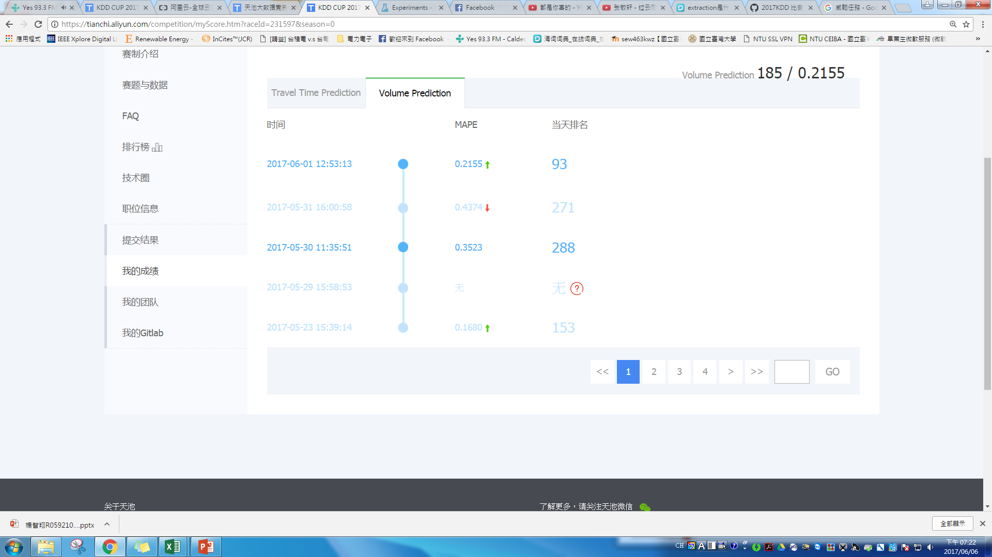
第二階段
Step2：訓練
成績: 0.3523
與第一階段的訓練流程、方式皆一樣，但MAPE卻偏高很多，可能原因
weather dataSets Feature Selection太少(只選擇precipitation)
training data還存在異值

Slide 43
第二階段
重新觀察training data與testing data之趨勢發現
(tollgate_id 1, direction 0)week1,week7
(tollgate_id 2, direction 0)week1,week7
(tollgate_id 3, direction 1)week1,week7
完全無法對應

Slide 44
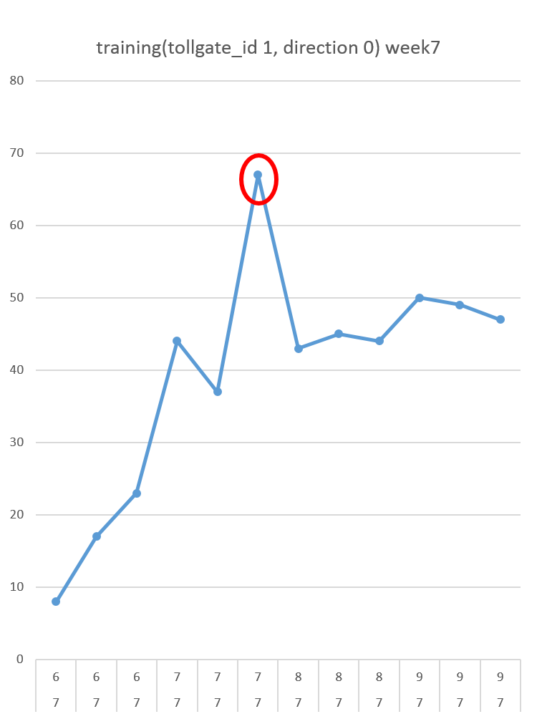
testing(tollgate_id 1, direction 0) week7
第二階段
以(tollgate_id 1, direction 0) week7為例：

Slide 45
第二階段
15、16點至17、18點做法一樣

Slide 46
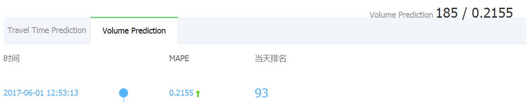
第二階段
Step2：訓練
最後成績: 0.2155

Slide 47
分配工作表
工作 姓名 | 資類分類、處理 | 資料訓練 | 報告製作
呂天桂D04921008 |  |  | 
林柏年R05921022
楊智翔R05921027

Slide 48
Thanks for Listening

